Slide 1
Graphs

Slide 2
GRAPH – Definitions
A graph G = (V, E) consists of
  a set of vertices, V, and
  a set of edges, E, where each edge is a pair (v,w) s.t. v,w ∈ V
Vertices are sometimes called nodes, edges are sometimes called arcs.
If the edge pair is ordered then the graph is called a directed graph (also called digraphs) .
We also call a normal graph (which is not a directed graph) an undirected graph.
  When we say graph we mean that it is an undirected graph.

Slide 3
Graph – Definitions
Two vertices of a graph are adjacent if they are joined by an edge.
Vertex w is adjacent to v iff (v,w) ∈ E.
  In an undirected graph with edge (v, w) and hence (w,v) w is adjacent to v and v is adjacent to w.
A path between two vertices is a sequence of edges that begins at one vertex and ends at another vertex.
  i.e. w₁, w₂, …, w_{N} is a path if (w_{i}, w_{i+1}) ∈ E for 1 ≤ i ≤. N-1
A simple path passes through a vertex only once.
A cycle is a path that begins and ends at the same vertex.
A simple cycle is a cycle that does not pass through other vertices more than once.

Slide 4
Graph – An Example
1
2
A graph G (undirected)
3
4
5
The graph G= (V,E) has 5 vertices and 6 edges:
V = {1,2,3,4,5}
E = { (1,2),(1,3),(1,4),(2,5),(3,4),(4,5), (2,1),(3,1),(4,1),(5,2),(4,3),(5,4) }
Adjacent:
  1 and 2 are adjacent -- 1 is adjacent to 2 and 2 is adjacent to 1
Path:
  1,2,5 ( a simple path), 1,3,4,1,2,5 (a path but not a simple path)
Cycle:
1,3,4,1 (a simple cycle), 1,3,4,1,4,1 (cycle, but not simple cycle)

Slide 5
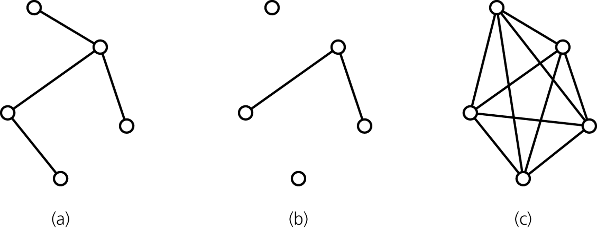
Graph -- Definitions
A connected graph has a path between each pair of distinct vertices.
A complete graph has an edge between each pair of distinct vertices.
  A complete graph is also a connected graph. But a connected graph may not be a complete graph.
connected
disconnected
complete

Slide 6
Directed Graphs
If the edge pair is ordered then the graph is called a directed graph (also called digraphs) .
Each edge in a directed graph has a direction, and each edge is called a directed edge.
Definitions given for undirected graphs apply also to directed graphs, with changes that account for direction.
Vertex w is adjacent to v iff (v,w) ∈ E.
  i.e. There is a direct edge from v to w
  w is successor of v
  v is predecessor of w
A directed path between two vertices is a sequence of directed edges that begins at one vertex and ends at another vertex.
  i.e. w₁, w₂, …, w_{N} is a path if (w_{i}, w_{i+1}) ∈ E for 1 ≤ i ≤. N-1

Slide 7
Directed Graphs
A cycle in a directed graph is a path of length at least 1 such that w₁ = w_{N}.
  This cycle is simple if the path is simple.
  For undirected graphs, the edges must be distinct
A directed acyclic graph (DAG) is a type of directed graph having no cycles.
An undirected graph is connected if there is a path from every vertex to every other vertex.
A directed graph with this property is called strongly connected.
  If a directed graph is not strongly connected, but the underlying graph (without direction to arcs) is connected then the graph is weakly connected.

Slide 8
Directed Graph – An Example
1
2
3
4
5
The graph G= (V,E) has 5 vertices and 6 edges:
V = {1,2,3,4,5}
E = { (1,2),(1,4),(2,5),(4,5),(3,1),(4,3) }
Adjacent:
  2 is adjacent to 1, but 1 is NOT adjacent to 2
Path:
  1,2,5 ( a directed path),
Cycle:
1,4,3,1 (a directed cycle),

Slide 9
Weighted Graph
We can label the edges of a graph with numeric values, the graph is called a weighted graph.
1
8
2
Weighted (Undirected) Graph
10
3
6
3
5
4
7
5
1
8
2
Weighted Directed Graph
10
3
6
3
5
4
7
5

Slide 10
Graph Implementations
The two most common implementations of a graph are:
  Adjacency Matrix
    A two dimensional array
  Adjacency List
    For each vertex we keep a list of adjacent vertices

Slide 11
Adjacency Matrix
An adjacency matrix for a graph with n vertices numbered 0,1,...,n-1 is an n by n array matrix such that matrix[i][j] is 1 (true) if there is an edge from vertex i to vertex j, and 0 (false) otherwise.
When the graph is weighted, we can let matrix[i][j] be the weight that labels the edge from vertex i to vertex j, instead of simply 1, and let matrix[i][j] equal to ∞ instead of 0 when there is no edge from vertex i to vertex j.
Adjacency matrix for an undirected graph is symmetrical.
  i.e. matrix[i][j] is equal to matrix[j][i]
Space requirement O(|V|²)
Acceptable if the graph is dense.

Slide 12
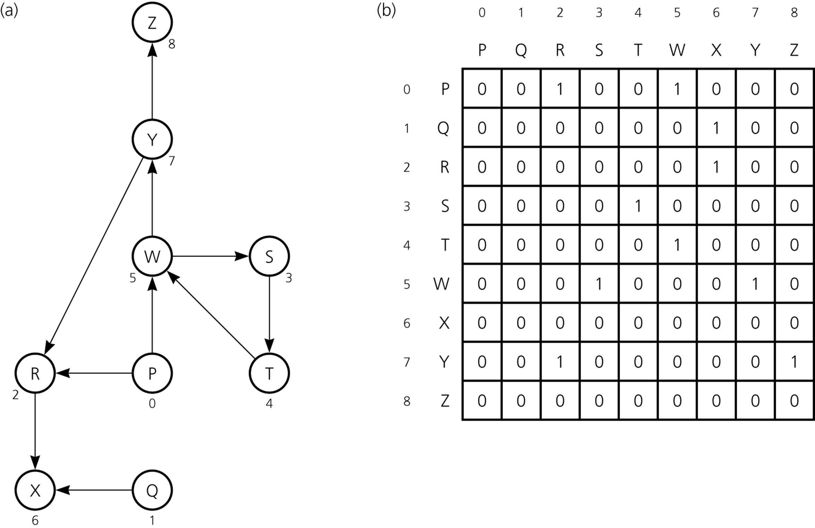
Adjacency Matrix – Example1
A directed graph
Its adjacency matrix

Slide 13
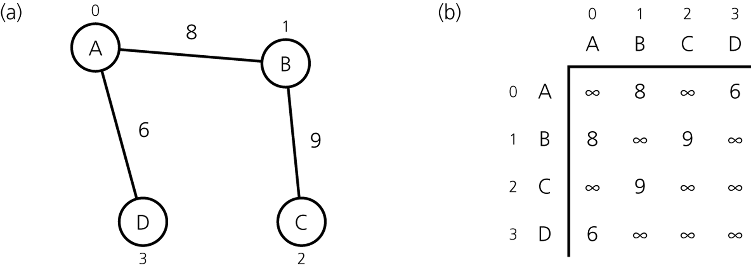
Adjacency Matrix – Example2
An Undirected Weighted Graph
Its Adjacency Matrix

Slide 14
Adjacency List
An adjacency list for a graph with n vertices numbered 0,1,...,n-1 consists of n linked lists. The i^{th} linked list has a node for vertex j if and only if the graph contains an edge from vertex i to vertex j.
Adjacency list is a better solution if the graph is sparse.
Space requirement is O(|E| + |V|), which is linear in the size of the graph.
In an undirected graph each edge (v,w) appears in two lists.
  Space requirement is doubled.

Slide 15
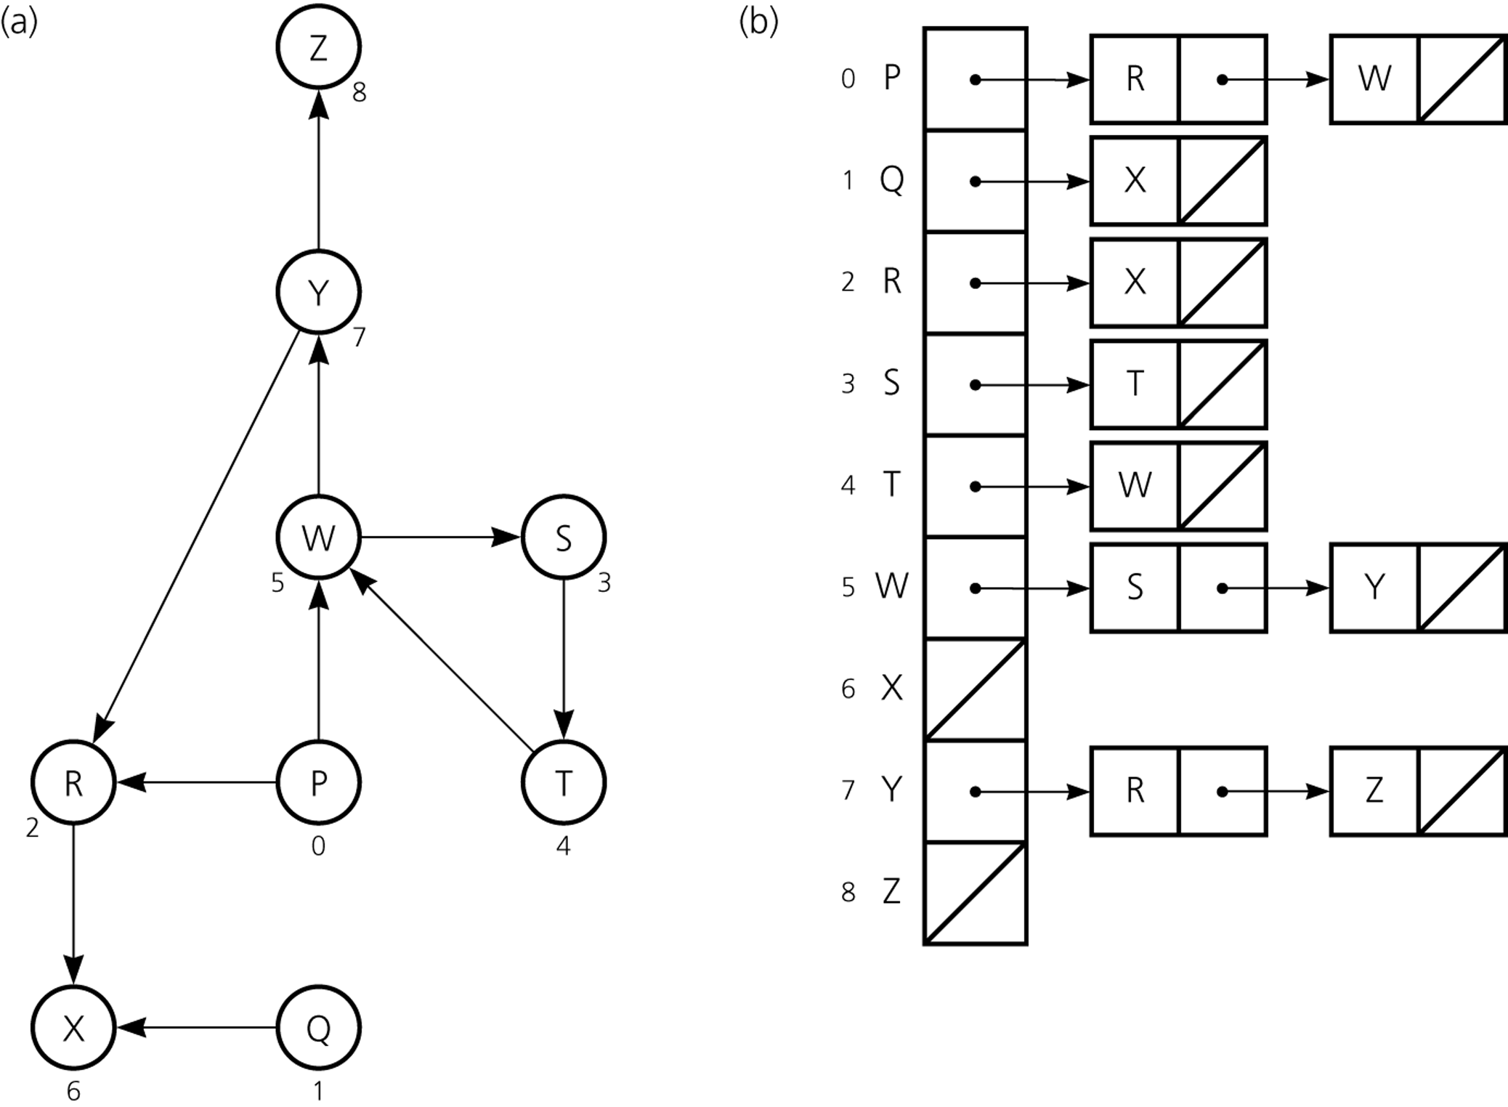
Adjacency List – Example1
A directed graph
Its Adjacency List

Slide 16
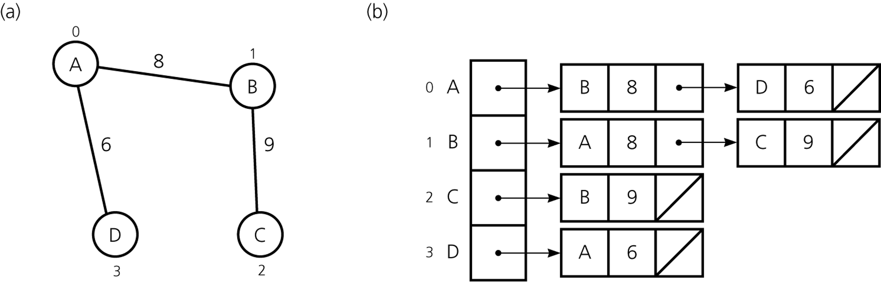
Adjacency List – Example2
An Undirected Weighted Graph
Its Adjacency List

Slide 17
Adjacency Matrix vs Adjacency List
Two common graph operations:
  Determine whether there is an edge from vertex i to vertex j.
  Find all vertices adjacent to a given vertex i.
An adjacency matrix supports operation 1 more efficiently.
An adjacency list supports operation 2 more efficiently.
An adjacency list often requires less space than an adjacency matrix.
  Adjacency Matrix: Space requirement is O(|V|²)
  Adjacency List : Space requirement is O(|E| + |V|), which is linear in the size of the graph.
  Adjacency matrix is better if the graph is dense (too many edges)
  Adjacency list is better if the graph is sparse (few edges)

Slide 18
Graph Traversals
A graph-traversal algorithm starts from a vertex v, visits all of the vertices that can be reachable from the vertex v.
A graph-traversal algorithm visits all vertices if and only if the graph is connected.
A connected component is the subset of vertices visited during a traversal algorithm that begins at a given vertex.
A graph-traversal algorithm must mark each vertex during a visit and must never visit a vertex more than once.
  Thus, if a graph contains a cycle, the graph-traversal algorithm can avoid infinite loop.
We look at two graph-traversal algorithms:
  Depth-First Search (aka Depth-First Traversal)
  Breadth-First Search (aka Breadth-First Traversal)

Slide 19
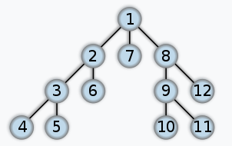
Depth-First Search
For a given vertex v, the depth-first search algorithm proceeds along a path from v as deeply into the graph as possible before backing up.
That is, after visiting a vertex v, the depth-first search algorithm visits (if possible) an unvisited adjacent vertex to vertex v.
The depth-first traversal algorithm does not completely specify the order in which it should visit the vertices adjacent to v.
  We may visit the vertices adjacent to v in sorted order.

Slide 20
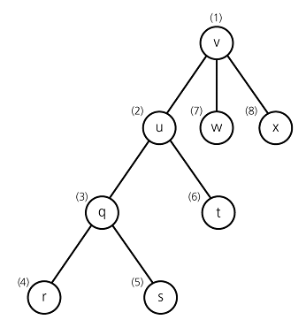
Depth-First Search – Example
A depth-first search of the
graph starting from vertex v.
Visit a vertex, then visit a vertex
adjacent to that vertex.
If there is no unvisited vertex adjacent
to visited vertex, back up to the previous
step.

Slide 21
Recursive Depth-First Search Algorithm
dfs(in v:Vertex) {
// Traverses a graph beginning at vertex v
// by using depth-first strategy
// Recursive Version
Mark v as visited;
for (each unvisited vertex u adjacent to v)
dfs(u)
}

Slide 22
Iterative Depth-First Search Algorithm
dfs(in v:Vertex) {
// Traverses a graph beginning at vertex v
// by using depth-first strategy: Iterative Version
s.createStack();
// push v into the stack and mark it
s.push(v);
Mark v as visited;
while (!s.isEmpty()) {
if (no unvisited vertices are adjacent to the vertex on
the top of stack)
s.pop(); // backtrack
else {
Select an unvisited vertex u adjacent to the vertex
on the top of the stack;
s.push(u);
Mark u as visited;
}
}
}

Slide 23
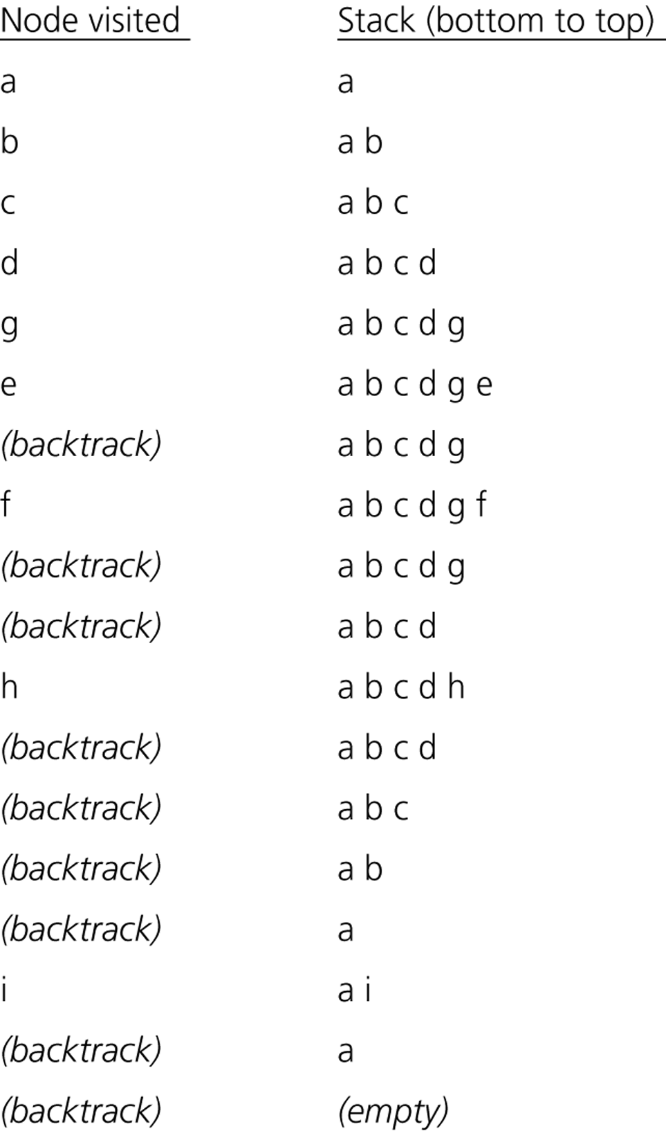
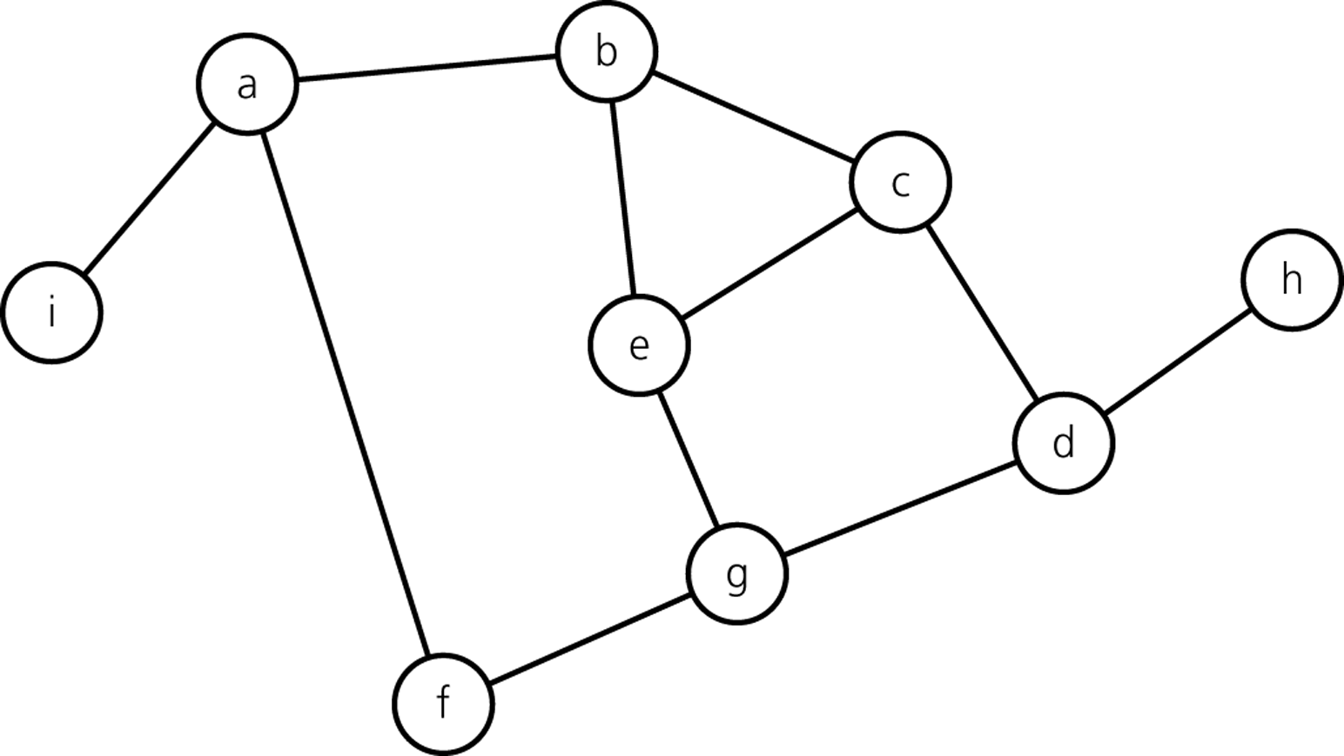
Trace of Iterative DFS – starting from vertex a
1
2
3
8
9
6
4
5
7

Slide 24
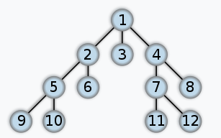
Breadth-First Search
After visiting a given vertex v, the breadth-first search algorithm visits every vertex adjacent to v that it can before visiting any other vertex.
The breadth-first traversal algorithm does not completely specify the order in which it should visit the vertices adjacent to v.
  We may visit the vertices adjacent to v in sorted order.

Slide 25
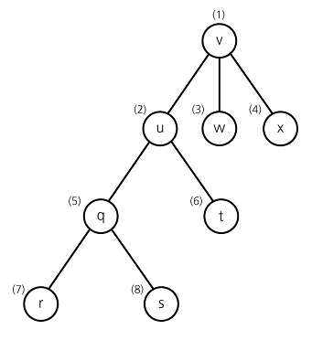
Breadth-First Search– Example
A breadth-first search of the
graph starting from vertex v.
Visit a vertex, then visit all vertices
adjacent to that vertex.

Slide 26
Iterative Breadth-First Search Algorithm
bfs(in v:Vertex) {
// Traverses a graph beginning at vertex v
// by using breath-first strategy: Iterative Version
q.createQueue();
// add v to the queue and mark it
q.enqueue(v);
Mark v as visited;
while (!q.isEmpty()) {
q.dequeue(w);
for (each unvisited vertex u adjacent to w) {
Mark u as visited;
q.enqueue(u);
}
}
}

Slide 27
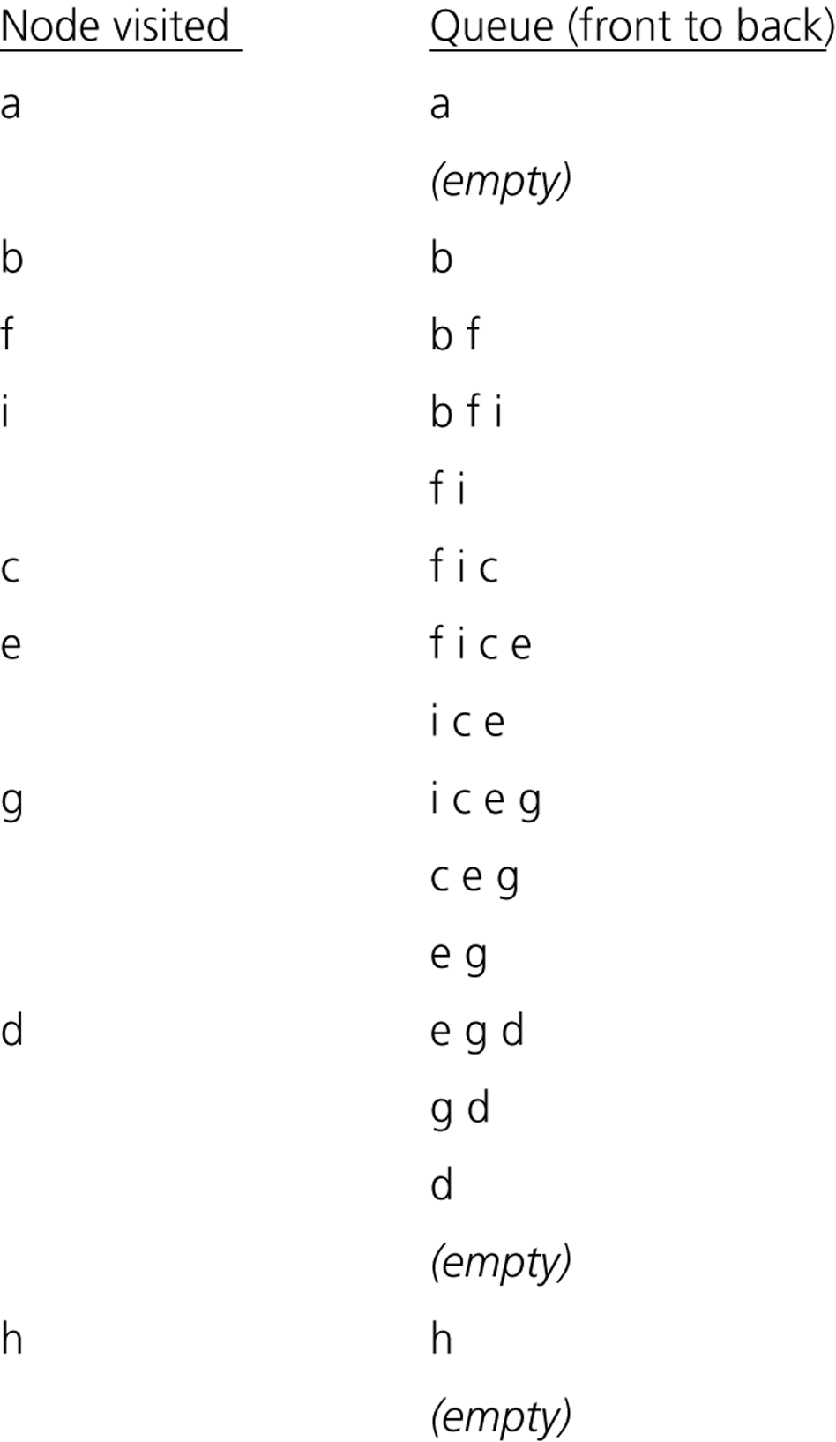
Trace of Iterative BFT – starting from vertex a
2
1
5
9
4
6
8
7
3

Slide 28
Exercise
d
a) Give the sequence of vertices when they are traversed starting from the vertex a using the depth-first search algorithm.
b) Give the sequence of vertices when they are traversed starting from the vertex a using the breadth-first search algorithm.
b
e
a
h
c
f
g

Slide 29
Some Graph Algorithms
Shortest Path Algorithms
  Unweighted shortest paths
  Weighted shortest paths (Dijkstra’s Algorithm)
Topological sorting
Network Flow Problems
Minimum Spanning Tree
Depth-first search Applications

Slide 30
Unweighted Shortest-Path problem
Find the shortest path (measured by number of edges) from a designated vertex S to every vertex.
1
2
3
4
5
6
7

Slide 31
Algorithm
Start with an initial node s.
  Mark the distance of s to s, D_{s} as 0.
  Initially D_{i} = ∞ for all i ≠ s.
Traverse all nodes starting from s as follows:
  If the node we are currently visiting is v, for all w that are adjacent to v:
    Set D_{w} = D_{v} + 1 if D_{w} = ∞.
  Repeat step 2.1 with another vertex u that has not been visited yet, such that D_{u} = D_{v} (if any).
  Repeat step 2.1 with another unvisited vertex u that satisfies D_{u} = D_{v} +1.(if any)

Slide 32
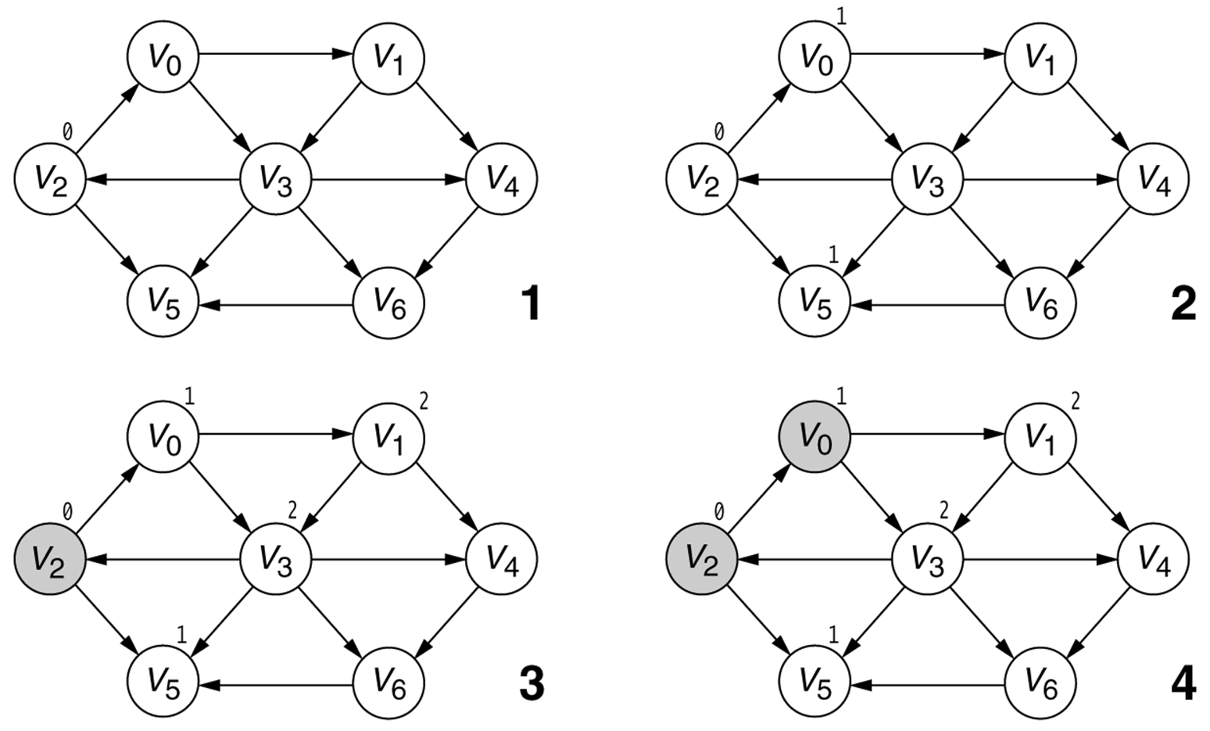
Figure 14.21A
Searching the graph in the unweighted shortest-path computation. The darkest-shaded vertices have already been completely processed, the lightest-shaded vertices have not yet been used as v, and the medium-shaded vertex is the current vertex, v. The stages proceed left to right, top to bottom, as numbered (continued).
Notes:
lec00-recursion

Slide 33
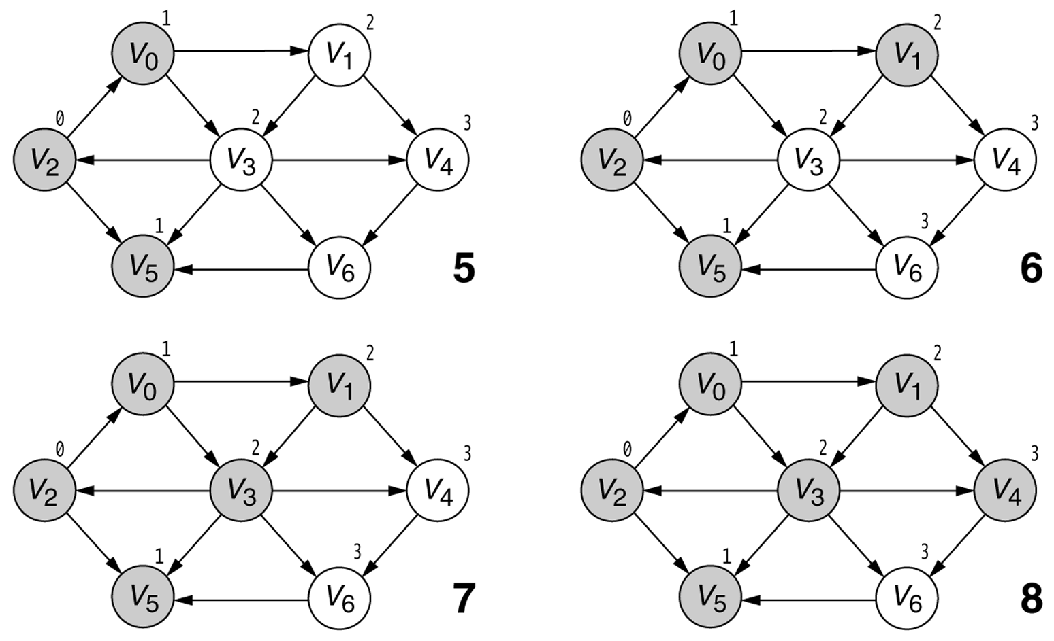
Figure 14.21B
Searching the graph in the unweighted shortest-path computation. The darkest-shaded vertices have already been completely processed, the lightest-shaded vertices have not yet been used as v, and the medium-shaded vertex is the current vertex, v. The stages proceed left to right, top to bottom, as numbered.
Notes:
lec00-recursion

Slide 34
Unweighted shortest path algorithm
void Graph::unweighted_shortest_paths(vertex s)
{
//An application of BFS: Finding the shortest path between //two nodes u and v, with path length measured by # of edges
Queue<Vertex> q;
Vertex v,w;
for each Vertex v
v.dist = INFINITY;
s.dist = 0;
q.enqueue(s);
while (!q.isEmpty())
{
v= q.dequeue();
v.known = true; // not needed anymore
for each w adjacent to v
if (w.dist == INFINITY)
{
w.dist = v.dist + 1;
w.path = v;
q.enqueue(w);
}
} }

Slide 35
Weighted Shortest-path Problem
Find the shortest path (measured by total cost) from a designated vertex S to every vertex. All edge costs are nonnegative.
2
1
2
4
3
10
1
4
2
5
3
2
8
4
5
2
6
1
7

Slide 36
Weighted Shortest-path Problem
The method used to solve this problem is known as Dijkstra’s algorithm.
  An example of a greedy algorithm
  Use the local optimum at each step
Solution is similar to the solution of unweighted shortest path problem.
The following issues must be examined:
  How do we adjust D_{w}?
  How do we find the vertex v to visit next?

Slide 37
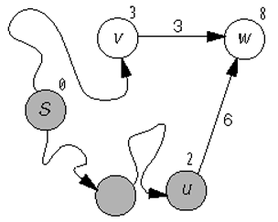
Figure 14.23
The eyeball is at v and w is adjacent, so D_{w} should be lowered to 6.
Notes:
lec00-recursion

Slide 38
Dijkstra’s algorithm
The algorithm proceeds in stages.
At each stage, the algorithm
  selects a vertex v, which has the smallest distance D_{v} among all the unknown vertices, and
  declares that the shortest path from s to v is known.
  then for the adjacent nodes of v (which are denoted as w) D_{w} is updated with new distance information
How do we change D_{w}?
  If its current value is larger than D_{v} + c _{v,w} we change it.

Slide 39
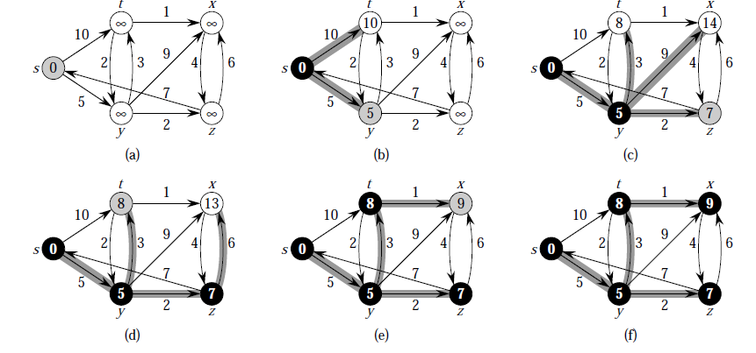
An example for Dijkstra’s Shortest Paths Algorithm
Notes:
lec00-recursion

Slide 40
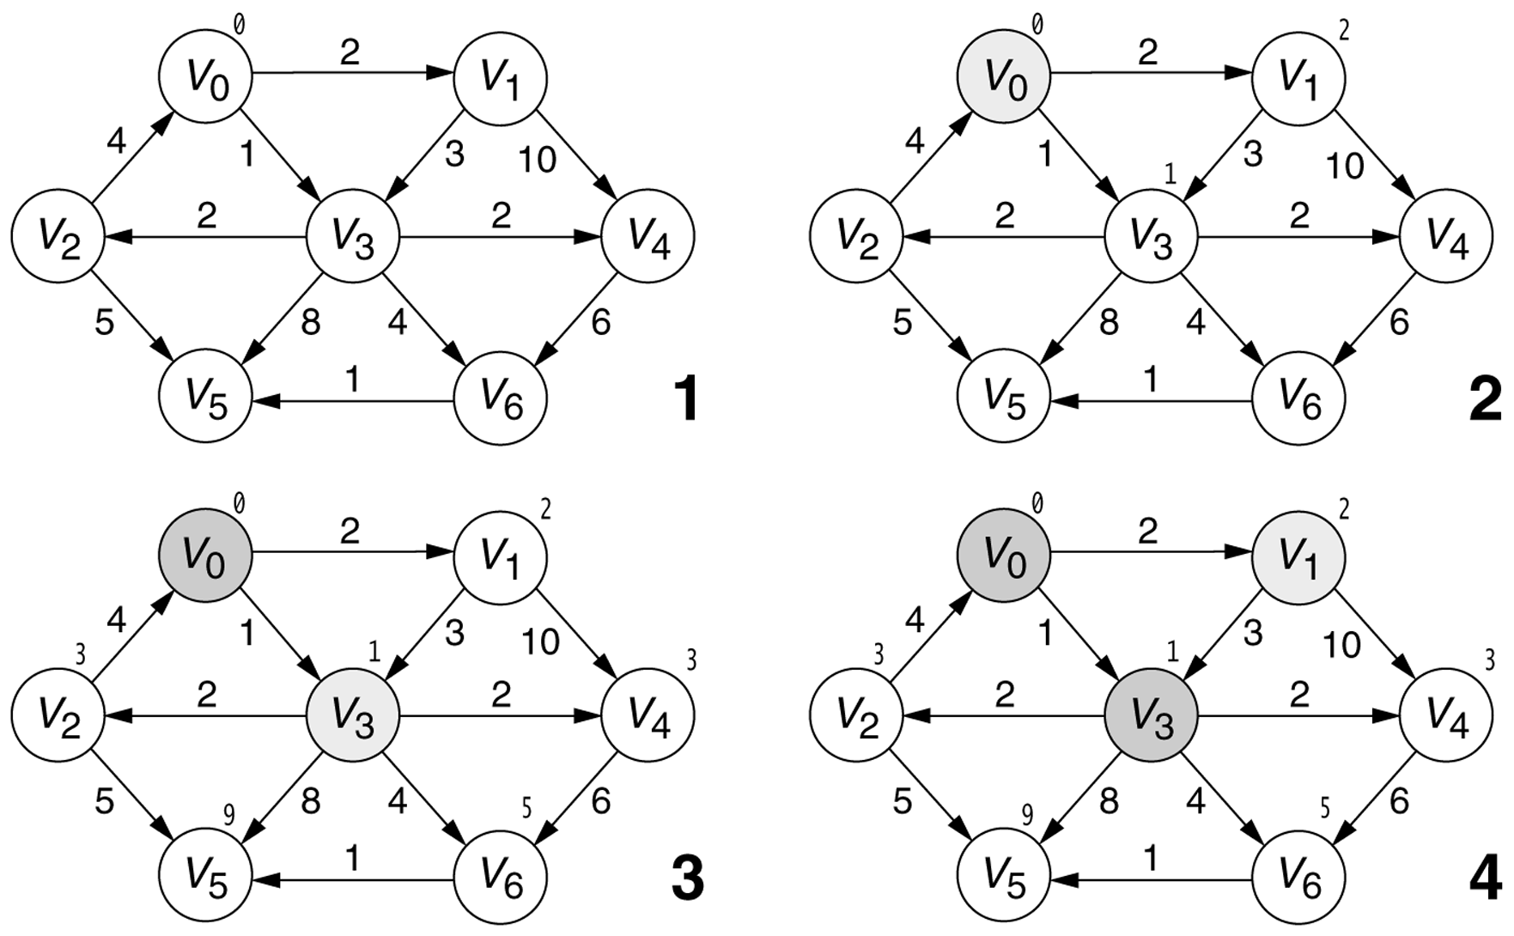
Figure 14.25A
Stages of Dijkstra’s algorithm. The conventions are the same as those in
Figure 14.21 (continued).
Notes:
lec00-recursion

Slide 41
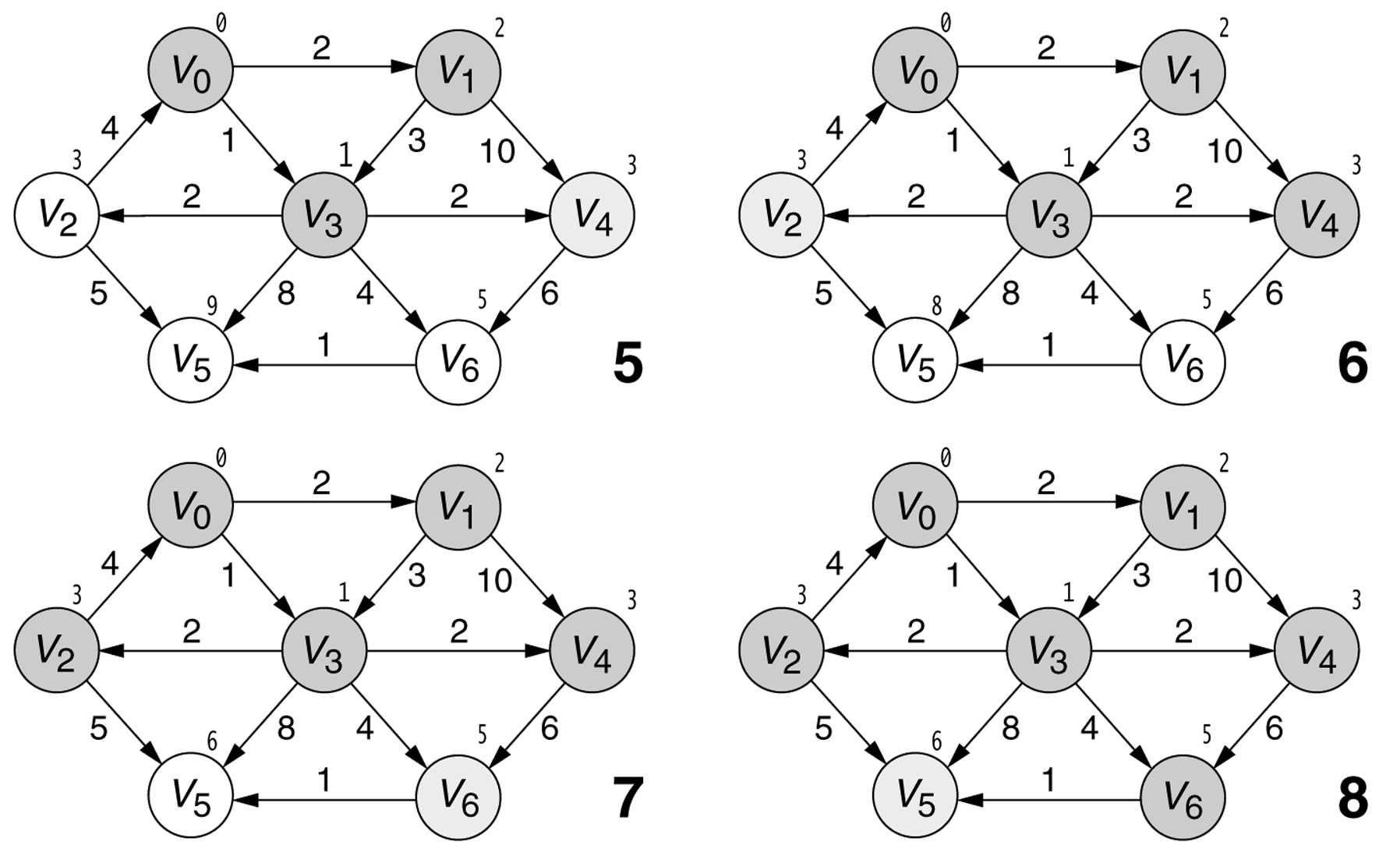
Figure 14.25B
Stages of Dijkstra’s algorithm. The conventions are the same as those in
Figure 14.21.
Notes:
lec00-recursion

Slide 42
Implementation
A queue is no longer appropriate for storing vertices to be visited.
The priority queue is an appropriate data structure.
Add a new entry consisting of a vertex and a distance, to the priority queue every time a vertex has its distance lowered.

Slide 43
Shortest Paths: Dijkstra’s Algorithm
PriorityQueue<Vertex> pq;
For each node v { v.dist = ∞; v.path = null; }
s.dist = 0;
add all vertices to pq;
while(!pq.isEmpty()) { O(V)
Vertex v = pq.deleteMin(); //O(logV), O(V) if arrayused
for each edge(v,w) //O(E)
alt = v.dist + weight(v,w);
if (alt < w.dist) {
update w.dist = v.dist + weight(v,w);
w.path = v;
pq.decrease_priority(w,alt); //O(logV)
//Amortized O(1) if Fibonacci heap used
//O(1) if array used
}} }

Slide 44
Shortest Paths: Dijkstra’s Algorithm
Analysis:
With priority queue: O(|V|log|V|+|E|log|V|) → O(|E|log|V|)
O(|V|log|V|+|E|) //with Fibonacci heap
Without priority queue (e.g., array):
O(|V|² + |E|) → O(|V|²)

Slide 45
Topological Sorting
A topological sort of a dag G = (V, E) is a linear ordering of all its vertices such that if G contains an edge (u, v), then u appears before v in the ordering. (If the graph is not acyclic, then no linear ordering is possible.)
A topological sort of a graph can be viewed as an ordering of its vertices along a horizontal line so that all directed edges go from left to right.
Different from the usual kind of Sorting we studied before
Notes:
lec00-recursion

Slide 46
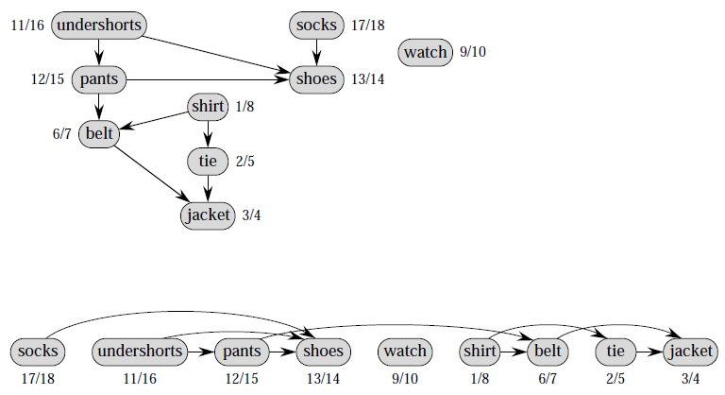
Topological Sorting
Prof. Yusuf topologically sorts his clothing when getting dressed
Notes:
lec00-recursion

Slide 47
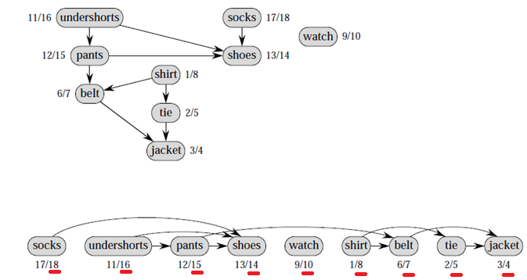
Topological Sorting
TOPOLOGICAL-SORT(G)
Call DFS(G) to compute finishing times f [v] for each vertex v
As each vertex is finished, insert it onto the front of a linked list
return the linked list of vertices
Notes:
lec00-recursion

Slide 48
Topological Sorting
Analysis:
TOPOLOGICAL-SORT(G) takes O(|V| + |E|) time as
DFS takes O(|V| + |E|) and insertion to list takes O(1) for each |V| vertices

Slide 49
Topological Sorting
Applications (other than dressing you up)
Resolving dependencies
  To build dll A, you must have built DLLs B, C an D (Maybe you have a reference of B,C and D in the project that builds A). You mark a dependency edge from each of B, C and D to A implying that A depends on the other three and can only be built once each of the three are built. After constructing a graph of these dlls and dependency edges, you can conclude that a successful build is possible iff the resulting graph is acyclic. How does the build system decide in which order to build these dlls? It sorts them topologically.
  Therefore, in an order like X->Z->T->B->D->C->A, it can start building X (which may only depend on external assemblies already built), then follow the topologically sorted list of assemblies.
Many other task scheduling jobs

